Slide 1
SOEN 384
Management, Measurement and Quality Control http://users.encs.concordia.ca/~s384_2/
Instructor: Dr. Olga Ormandjieva
Lecture 18:
ISO15939 financial performance measurement model.
Software Project Planning KA 2.5: Risk Management (1)

Slide 2
Agenda
Review
ISO15939 financial performance measurement model
Definition of Risk Management
Risks and their management in Cost Estimation
Key points?
SOEN384-L18: risk management (1)

Slide 3
Key questions answered by earned-value analysis
We monitor past performance to control the future performance
PAST PRESENT FUTURE
Are we on schedule?
Are we on cost?
What are the significant variances?
What is the trend to date?
When will we finish?
What will it cost at the end?
How can we control the trend?
The Two Key Questions
1. Did we get what we wanted for what we spent?
2. At the end of the project, is it likely that the cost will be less than or equal to the original estimate?
SOEN384-L18: risk management (1)

Slide 4
Performance indicators
Are we on schedule?
Are we on cost?
What are the significant variances?
What is the trend to date?
  Planned Value (PV): for a given task, PV is defined as the effort planned for that task translated into cost.
  Budget at completion (BAC): sum of all planned value for ALL project’s or iteration’s tasks
  Earned Value (EV): % of PV of the work actually completed by a given point in time on the project schedule.
  Actual Cost (AC) (previously called Actual Cost of Work Performed - ACWP):The total of costs on tasks that have actually been completed and reported in EV by a given point in time on the project schedule.
SOEN384-L17: monitoring&control

Slide 5
Performance indicators
Are we on schedule?
Are we on cost?
What are the significant variances?
What is the trend to date?
The values for PV, AC and EV are used in combination to provide measures of whether or not work is being accomplished as planned.
  Cost Variance (CV)
  Schedule Variance (SV)
  Cost Performance Index (CPI)
  Schedule Performance Index (SPI)
SOEN384-L18: risk management (1)

Slide 6




More Performance indicators (cont.)
The values for PV, AC and EV are used in combination to provide measures of whether or not work is being accomplished as planned.
Percent scheduled for completion
Percent complete
estimate at completion (EAC)
Estimate to complete (ETC)
When will we finish?
What will it cost at the end?
How can we control the trend?
SOEN384-L18: risk management (1)

Slide 7
Agenda
Review
ISO15939 financial performance measurement model
Definition of Risk Management
Risks and their management in Cost Estimation
Key points?
SOEN384-L18: risk management (1)

Slide 8
ISO15939:
Financial Performance Example
Goal:
    The decision-maker in this example needs to assess the ability of the project to complete scheduled activities on time and within cost.
Information Need: determine if the project will complete scheduled activities on time and within cost.
Measurable concept:
    Financial performance
SOEN384-L18: risk management (1)

Slide 9
Financial Performance Example: Activity Tracking by milestone
Questions: What are the cost performance and the schedule performance?
Measures collected for every WBS activity:
  Planned Value PV
  Earned Value EV
  Actual Cost AC
SOEN384-L18: risk management (1)

Slide 10
Indicator 1:
Cost Performance Index (CPI)
Measurement function:
  Cost Performance Index (CPI) = EV / AC
  A ratio of the earned value over the actual cost of completed work
Analysis Model (Interpretation):
  CPI value close to 1.0: Provides a strong indication that the project is within its defined budget.
  CPI value < 1: Cost of completing the work is higher than planned.
  CPI value > 1: Cost of completing the work is less than planned.
Decision criteria: CPI should not exceed +-15%
SOEN384-L18: risk management (1)
Notes:
CPI value close to 1.0: Provides a strong indication that the project is within its defined budget.
CPI value < 1: Cost of completing the work is higher than planned.
CPI value > 1: Cost of completing the work is less than planned.

Slide 11
Indicator 2:
Schedule Performance Index (SPI)
Measurement function:
  Schedule Performance Index (SPI) = EV / PV
  Ratio of the earned value over the planned value.
  It indicates the rate of progress: the efficiency with which the project is utilizing scheduled resources.
Analysis Model (Interpretation):
  An SPI value close to 1.0 indicates efficient execution of the project schedule.
  SPIs > 1 are favorable.
  SPIs < 1 are not favorable.
Decision criteria: SPI should not exceed +-15%
Notes:
An SPI value close to 1.0 indicates efficient execution of the project schedule.
SPIs > 1 are favorable.
SPIs < 1 are not favorable

Slide 12
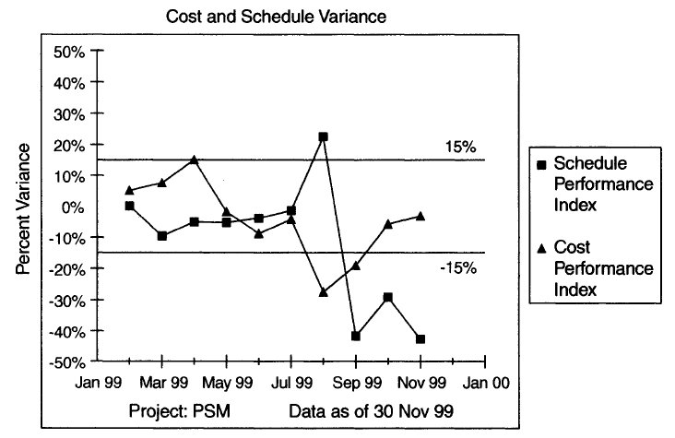
Financial Performance Indicators: SPI and CPI trends
SOEN384-L18: risk management (1)

Slide 13
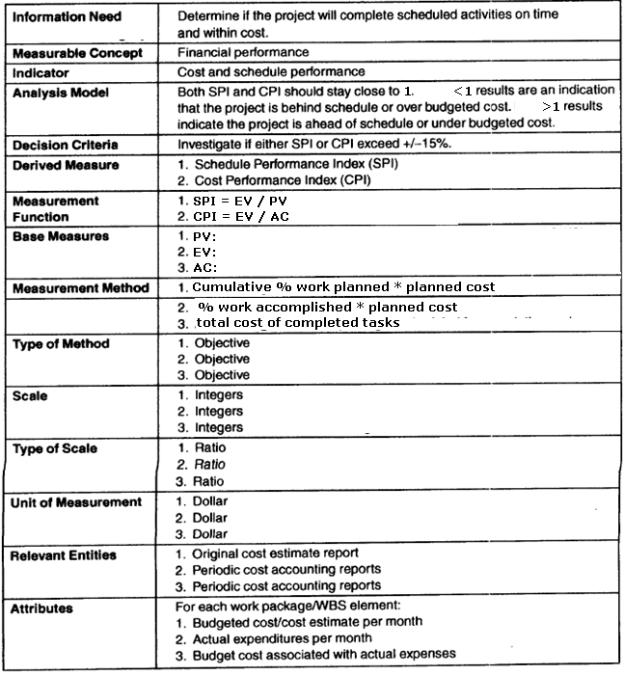
Financial Performance Measurement Plan Documentation: ISO 15939 template
SOEN384-L18: risk management (1)

Slide 14
Agenda
Review
ISO15939 financial performance measurement model
Definition of Risk Management
Risks and their management in Cost Estimation
Key points?
SOEN384-L18: risk management (1)

Slide 15
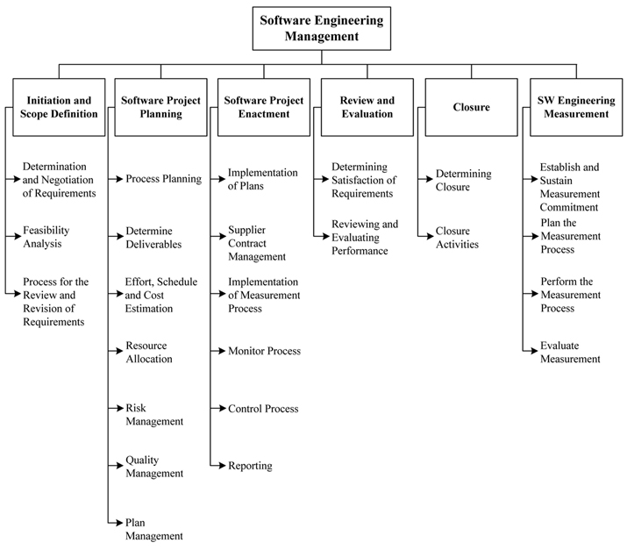
BREAKDOWN OF TOPICS FOR SOFTWARE ENGINEERING MANAGEMENT: SWEBOK
SOEN384-L18: risk management (1)

Slide 16
SWEBOK:
2.5. Risk Management
Risk identification and analysis (what can go wrong, how and why, and what are the likely consequences )
critical risk assessment (which are the most significant risks in terms of exposure, which can we do something about in terms of leverage),
risk mitigation and contingency planning (formulating a strategy to deal with risks and to manage the risk profile)
SOEN384-L18: risk management (1)

Slide 17
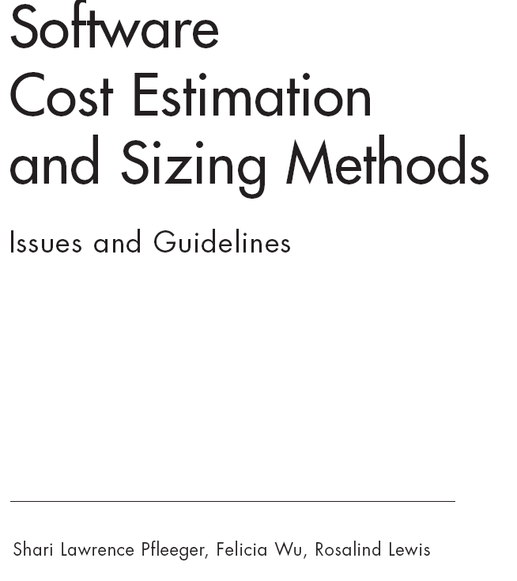
Example:
Risks in Cost Estimation
Source:
SOEN384-L18: risk management (1)

Slide 18
Risk and Software Cost Estimation
Sources of Risk in Software Estimates:
  sizing software (for example, COSMIC)
  using cost and effort estimation models
SOEN384-L18: risk management (1)
Notes:
Cost analysts must produce software cost
estimates for a variety of programs. Ideally, the estimated cost will
prove to be very close to the actual cost, and several estimation models
purport to be flexible enough to provide accurate estimates in almost
any situation. Unfortunately, this ideal is far from the reality. In
fact, some models work best when restricted to particular situations
or when applied using databases tailored to an organization’s particular
experiences.

Slide 19
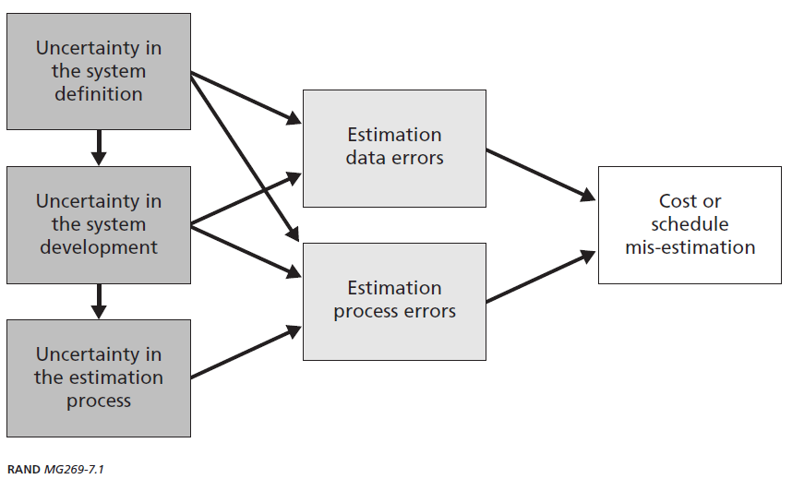
Sources of Risks in Cost Estimation
SOEN384-L18: risk management (1)
Notes:
What are the uncertainties and indicators of risk?
1. The problem is not sufficiently well defined. Symptoms may
include the following:
– Different people have different interpretations of what is
needed.
- There is inconsistency in the understanding of a project’s
size and needs, or there are changing conceptions of what
the project will do.
2. The system use is not well understood. Symptoms include
– The concept of operations is incomplete, inconsistent,
ambiguous, or does not exist.
3. The system is pushing the limits of technology. Evidence that
this is happening includes
– Key requirements or functions are included in the program
risk plan.
– Critical technologies have not been proven.

Slide 20
Examples of Risks related to system definition
There is inconsistency in the understanding of a project’s size and needs, or there are changing conceptions of what the project will do.
The system is pushing the limits of technology. Evidence that this is happening includes:
  Key requirements or functions are included in the program risk plan.
  Critical technologies have not been proven.
SOEN384-L18: risk management (1)

Slide 21
Examples of Risks related to system development
Critical-path activities are unknown or unresolvable, there is no “float (slack) time.”
Inadequate monitoring, mitigation, and reporting of the project’s achievement of planned milestones.
Information about risks, their probabilities of occurrence, and the consequences of loss are not available.
SOEN384-L18: risk management (1)

Slide 22
System Definition and Development Risks: Mitigation
Conduct several estimates over time. Then determine whether the system definition is converging over time.
Review program documentation, such as the system specification history, risk management plans, etc. to identify gaps and inconsistencies.
Use historical data and metrics from related or similar programs.
Use ranges for size and effort, rather than single values.
SOEN384-L18: risk management (1)

Slide 23
Examples of Risks related to the estimation process
An inappropriate model or method is used to estimate size and cost.
Input values for the cost and schedule data are incomplete or erroneous.
The model generates results that seem inconsistent with developers’ experience or expectations of what key cost factors are likely to be.
There are significant obstacles to comparing current information with past projections and actual costs or schedules.
SOEN384-L18: risk management (1)
Notes:
poor understanding of the system or the development
approach can contribute to the uncertainty, amplifying problems
by leading to selecting the wrong estimation method, applying the method incorrectly, or interpreting the results inappropriately.
For example, it can be very risky to use linear extrapolation from one
set of completed projects to the proposed project when the systems
are dramatically different in size, complexity, or some other critical
factor.

Slide 24
Estimation process Risks: Mitigation
By discussing the pros and cons of various cost-estimation methods
    Hint for the final exam: study the advantages and disadvantages of each cost estimation method seen in class (source: “Software Cost Estimation Methods: Issues and Guidelines”. )
By providing a concise risk checklist that can be applied to an existing or proposed cost-estimation method to help assess its appropriateness in a given situation.
Use multiple models to “triangulate” a reasonable estimate. In addition, verify reasonableness with experts.
Ensure that staff is trained on how to use each effort estimation model.
SOEN384-L18: risk management (1)
Notes:
Cost analysts must produce software cost
estimates for a variety of programs. Ideally, the estimated cost will
prove to be very close to the actual cost, and several estimation models
purport to be flexible enough to provide accurate estimates in almost
any situation. Unfortunately, this ideal is far from the reality. In
fact, some models work best when restricted to particular situations
or when applied using databases tailored to an organization’s particular
experiences.

Slide 25
Simple effort risk management with a simple measurement plan
(source: Dr. Sylvie Trudel)
A small Canadian software development organization established and sustained a measurement program for its software activities
The company’s business model is to provide each customer a “not to exceed” project estimate =>
  guarantees that fixing all defects found by their customer are free of charge.
  if the estimation is too high, the customer may decide to outsource the project elsewhere
  if the estimation is too low, the company does not make any profit and may even have to absorb a loss.
The motivation for a measurement program came from the inaccuracy of cost and effort estimates: HALF of the projects exceeded estimates!

Slide 26
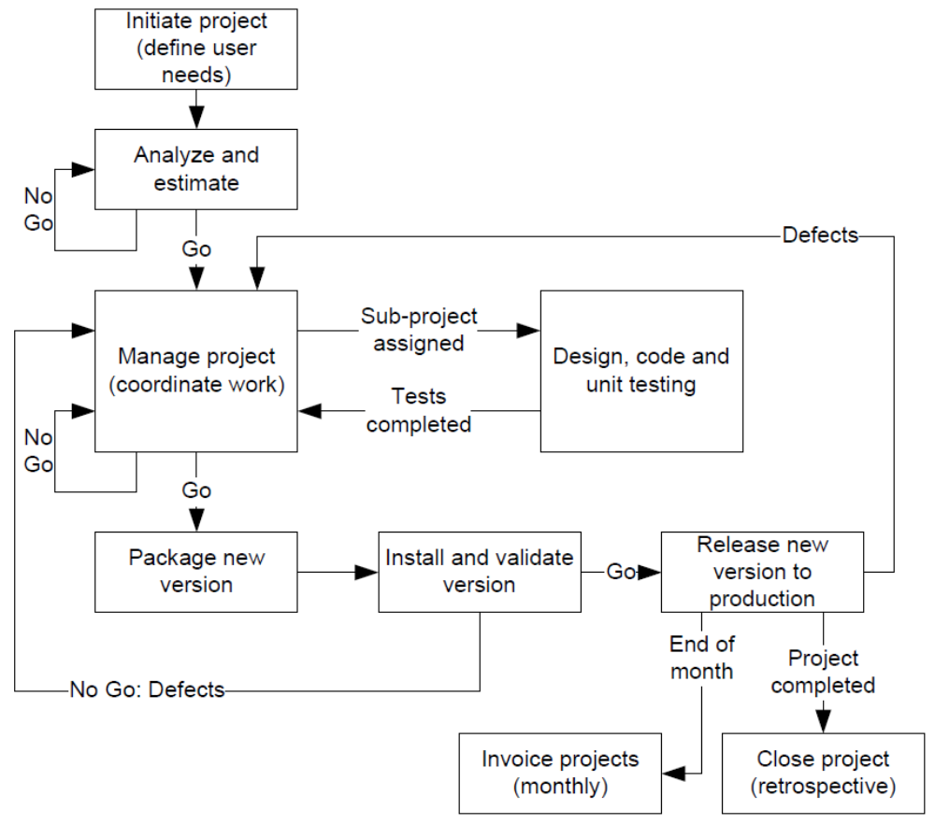
The company’s process: nine phases
SOEN384-L18: risk management (1)

Slide 27
Simple effort risk management with a simple measurement plan
(source: Dr. Sylvie Trudel)
GQM technique was used to derive a measurement plan
Goal: Deliver Projects within effort estimates
Reason: To reach corporate goal of 30% gross margin
SOEN384-L18: risk management (1)

Slide 28
Simple effort risk management:
Questions & Indicators
(source: Sylvie Trudel)
Question Q1: For each project, what is the difference between Actual Effort and Planned Effort?
  Indicator: (Actual Effort - (Planned Effort + Effort for Change Requests)) *100/ (Planned effort + Effort for Change Request)
  Change Requests could increase the actual effort up to 45%
Question Q2: What project proportion has an overrun of >5%?
  Indicator: (Number of projects of overrun >+5%) *100/ Total Number of Projects
  Interpretation: When >15%, adjust the model
SOEN384-L18: risk management (1)
Notes:
DC? Change Request

Slide 29
Simple effort risk management: some base measures related to goal G1
(source: Sylvie Trudel)
M1: actual effort
M2: Planned Effort
M3: Total Effort for all Change Requests
It was decided to include the measures and indicators in the project portfolio file to visualize a whole year of projects at a glance
Decisions and actions were taken based on the indicator values (see next)

Slide 30
Adjusting effort estimation with risk factors
The analysts and project manager discovered three risk factors that were influencing their productivity:
Technology (known or unknown)
Complexity (low, medium, high) related to knowledge of business domain and business process of the customer, and
Number of other stakeholders involved (none, third party from the client, one or many vendors).
Decision: Contingency was added as a percentage of total estimated effort when risk is perceived
  Total estimated effort = estimated effort + contingency%

Slide 31
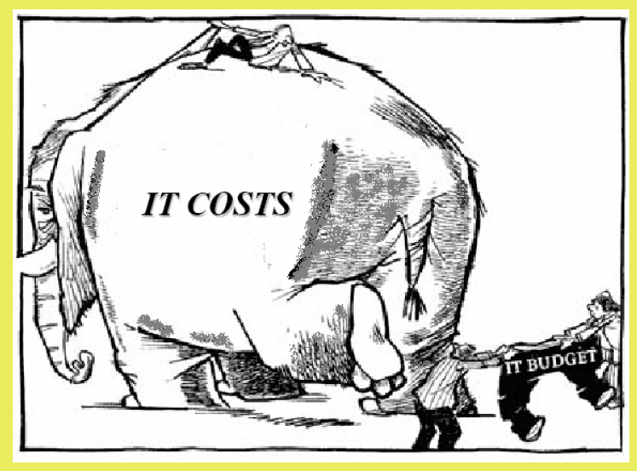
Financial Performance: Key Points
  A software development organization should strive to minimize the variation between the predicted and the actual values for cost, schedule, and resources
SOEN384-L18: risk management (1)

Slide 32
Next?
Risk Management process
Integrating risk management with project planning
SOEN384-L18: risk management (1)

